Slide 1
Analyzing Enron Emails
Team Noob Network:
Adarsh Chavakula
Gaurav Singh
Somya Singhal
Vinay Kale

Slide 2
Contents
Suspicious Network Analysis
Gender Prediction
Word Vectors Based Analysis
Topic Modeling
Community Clustering

Slide 3
Network Analysis
Our Hypothesis – Unethical communication practice happen in a small private group and beyond office hours
Narrow data to emails with at max 4 recipients
Focus on non-office hours (late nights and weekends)
Model network with edge weight = # mails exchanged
High threshold to focus on frequent communicators

Slide 4
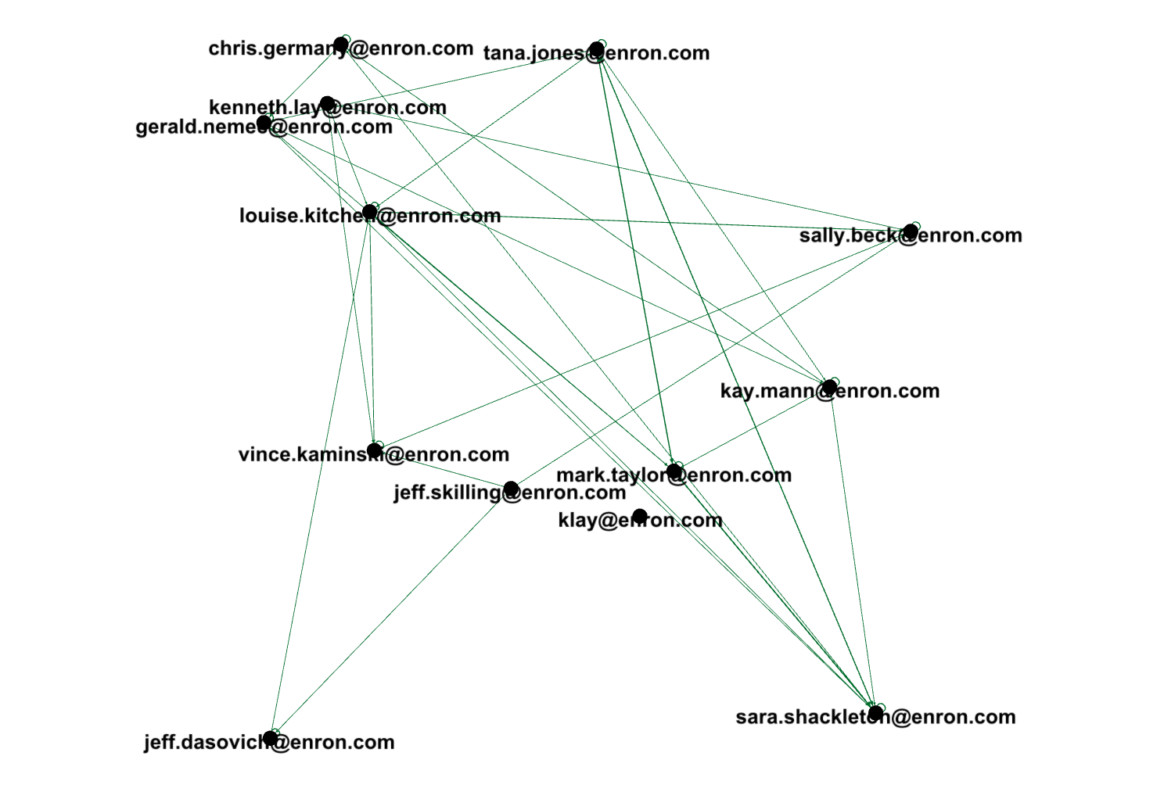
Network Analysis

Slide 5
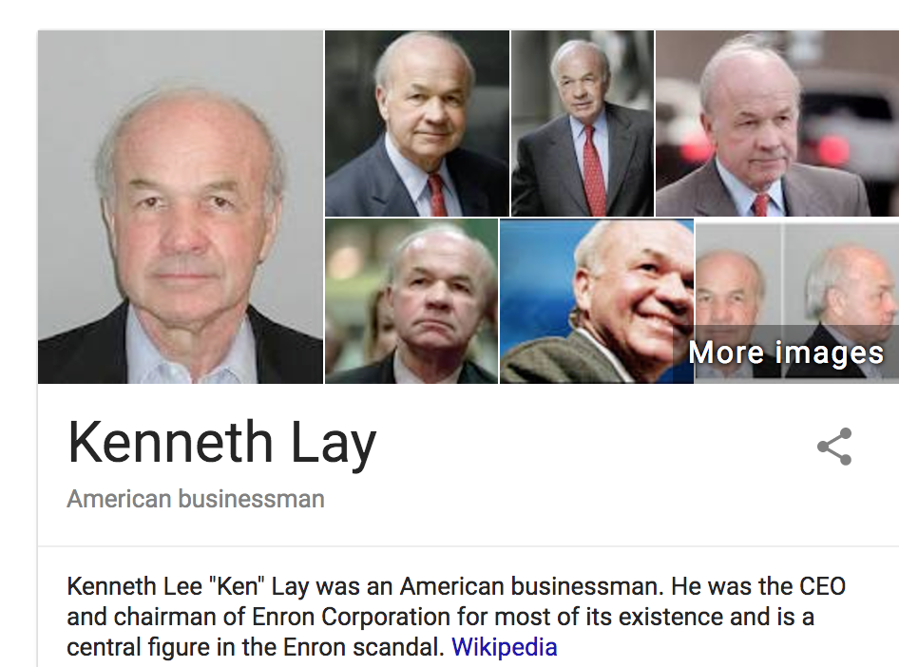
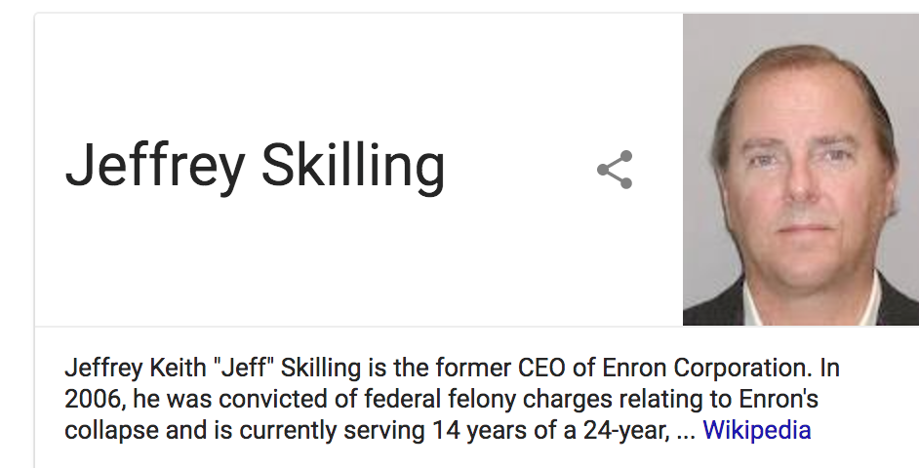
Key Perpetrators

Slide 6
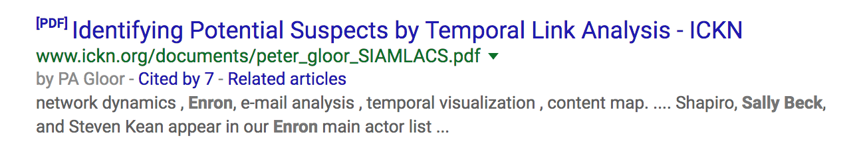
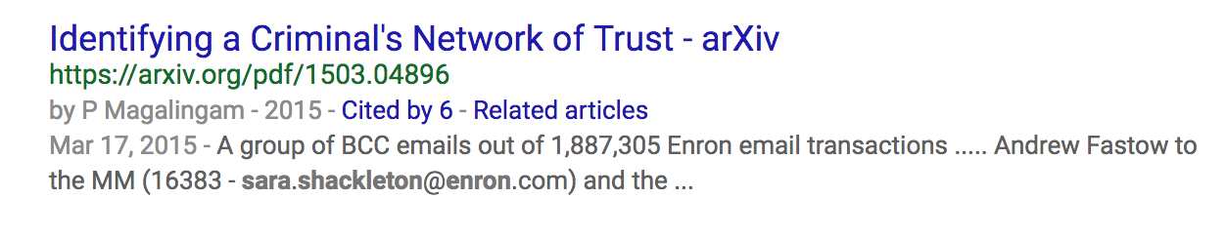
Person of Interest

Slide 7
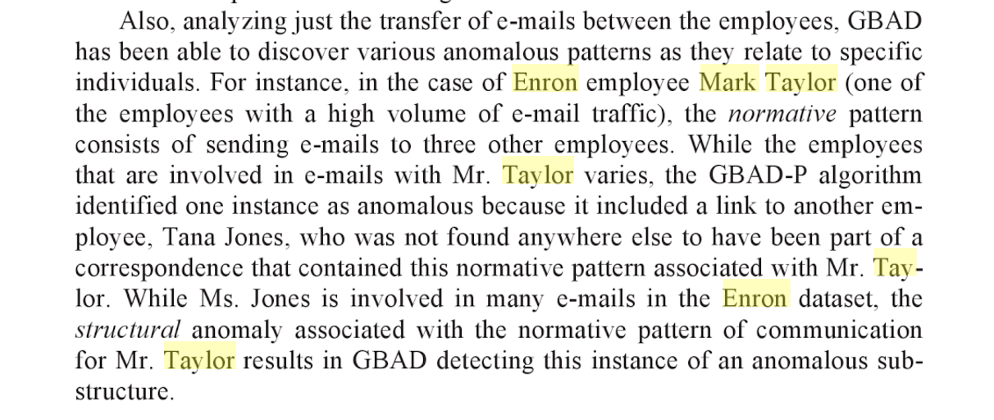

Anomalies detected
Text from book

Slide 8
Anomalies detected
Text from book

Slide 9
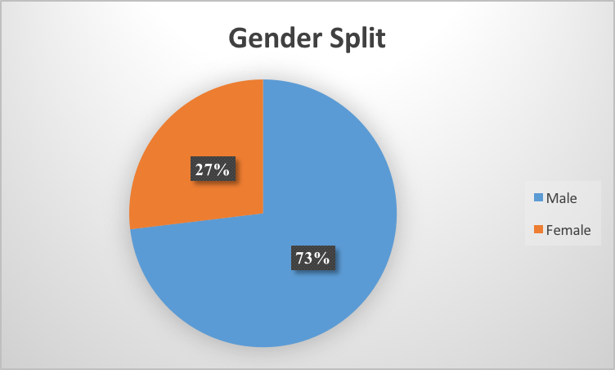
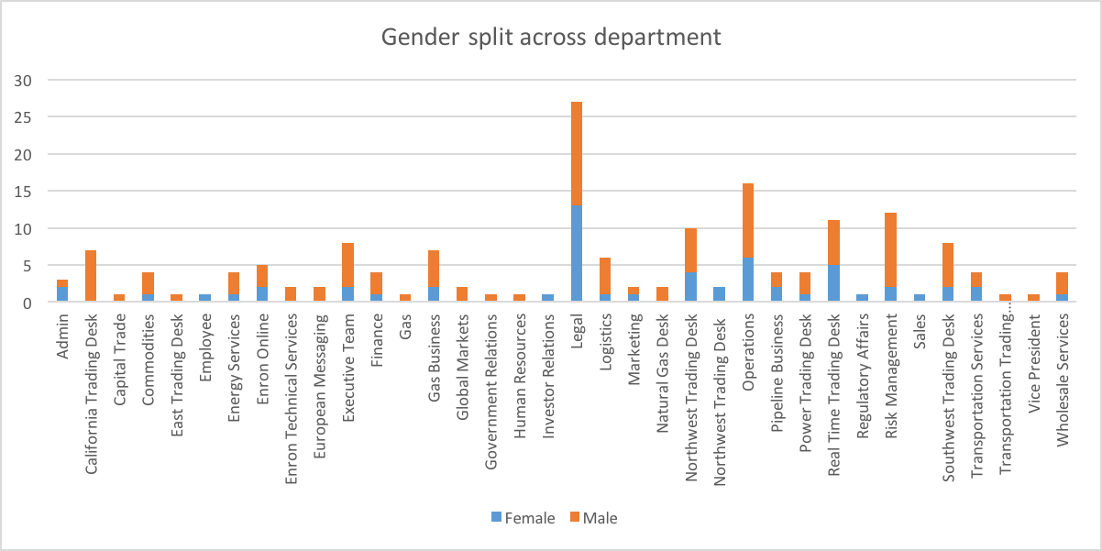
Gender Prediction
Using the Enron employee list partial data, we filtered the email addresses for names
Predictor which encodes gender based on names and dates of birth using historical datasets.
R package “gender”

Slide 10
Word Vectors
Our Hypothesis: Capture semantic meaning in emails to explore suspicious behavior
Word Embedding's: represent a word with a low-dimensional vector
Use distance metric to measure semantic similarity
Used a pre-trained google news model to incrementally train the Enron corpus and get best results

Slide 11
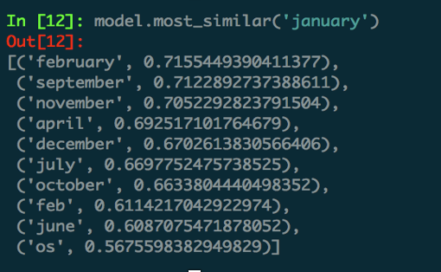
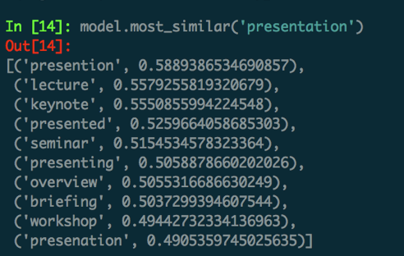
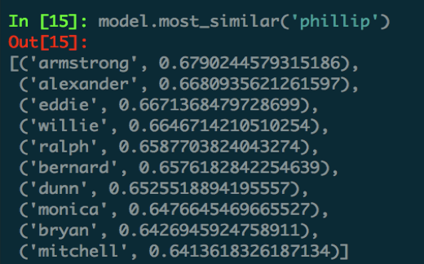
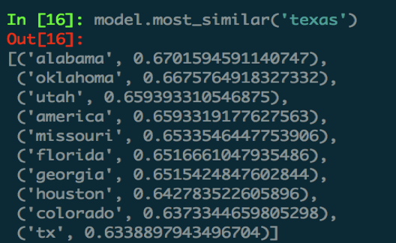
Word vectors examples : vocab size - 159,638 words, each word – 300 size vector

Slide 12
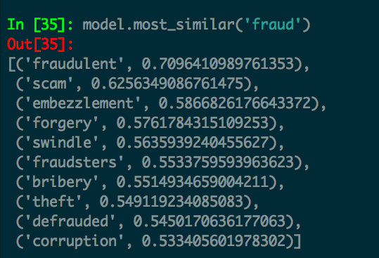
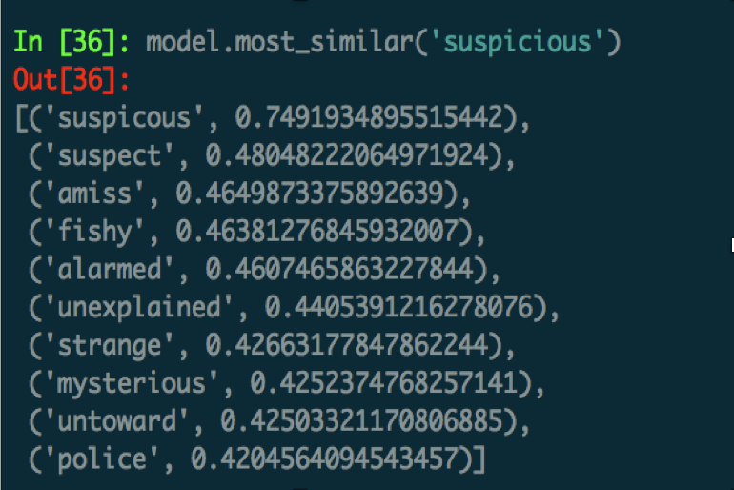
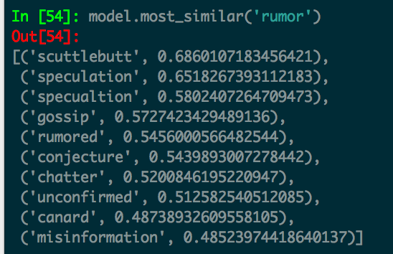
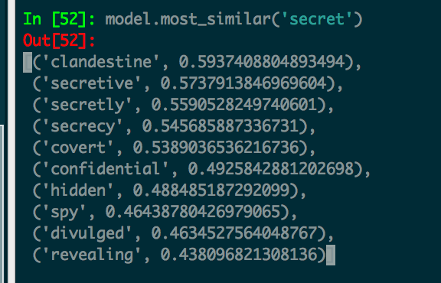
Word vectors use – Identifying suspicious / secrecy prone / rumor language

Slide 13
Word vectors use – High usage of suspicious words and instances of secrecy/ rumor language
From Email-ID | Occurrences | In Graph
kay.mann@enron.com | 3926
vince.kaminski@enron.com | 1924 | Yes
sara.shackleton@enron.com | 1643 | Yes
tana.jones@enron.com | 1472 | Yes
jeff.dasovich@enron.com | 1341 | Yes
exchangeinfo@nymex.com | 1135
steven.kean@enron.com | 992
richard.sanders@enron.com | 906
enron.announcements@enron.com | 835
mark.taylor@enron.com | 656 | Yes
veronica.espinoza@enron.com | 609
chris.germany@enron.com | 597 | Yes
sally.beck@enron.com | 590 | Yes
drew.fossum@enron.com | 496
gerald.nemec@enron.com | 472 | Yes
Find words relevant to suspicious, secret behavior
Check their occurrences across the email texts and rank people by highest usage
Do these guys feature in our previous network analysis ?
YES !!

Slide 14
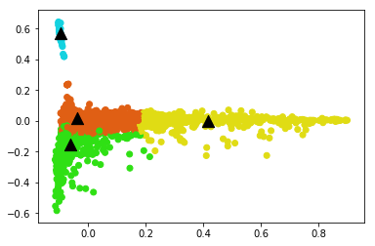
Topic Modeling (Recurring themes)
Email Etiquette
Message, Attach, Thank, Inform, Copy
Schedule related
Dinner
Call
Meeting
Week
Business Related
Enron
Corp
Fare
Renewables
Agreement
Deal
Bit Noise
Legal Related
Court
Paper
Enforcement
legal

Slide 15
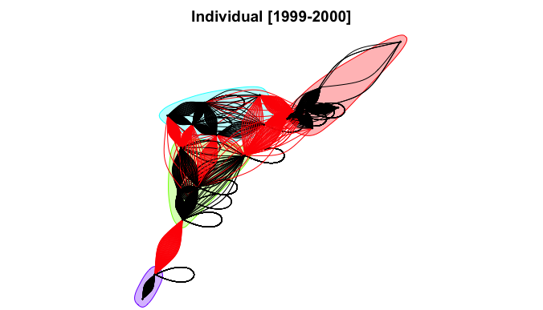
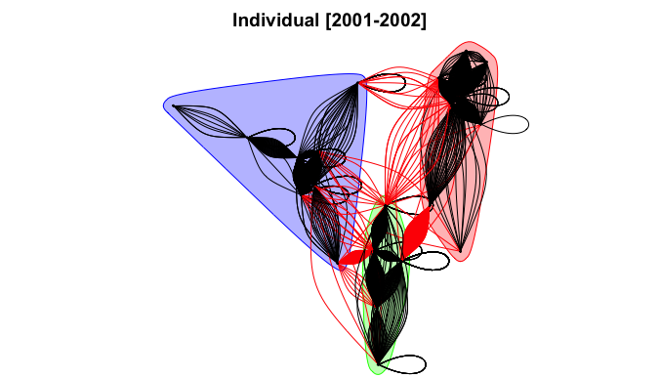
Email Network Community Collusion
Red Arrows are carriers
between communities
Colors of regions are communities
of closely connected people
Black arrows are information exchanged
within the community
Inference 1 : Fewer number of individual communities; more inter-community interactions were observed in the earlier time frame.

Slide 16
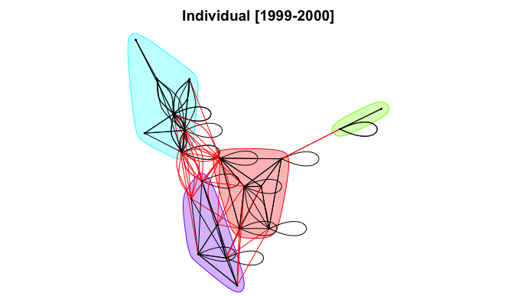
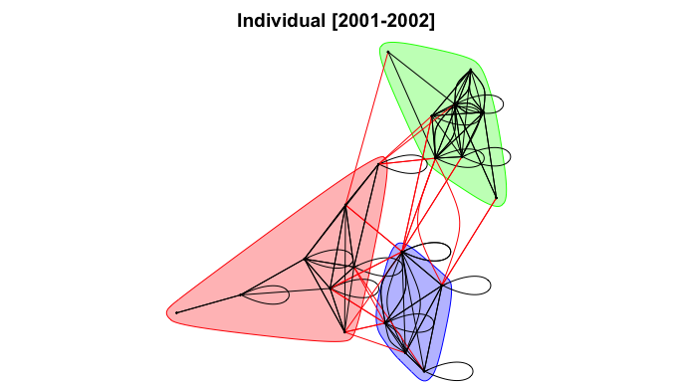
Email Connection Existence
Clearer pictures of the network
Who are the people sharing insider information between communities?
Self Arrows indicate mails sent to own
Inference 2 : Easy to observe email connectivity through interactive viz.; also email content can be reflected on the arrows.

Slide 17
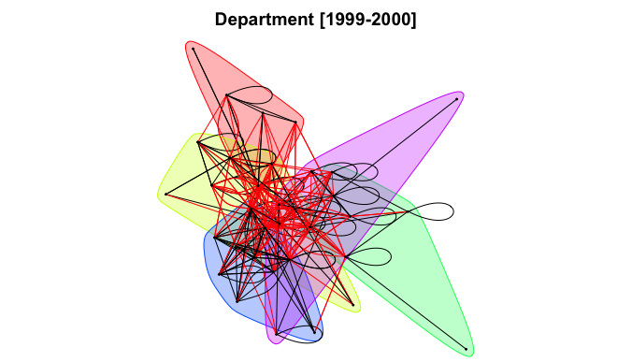
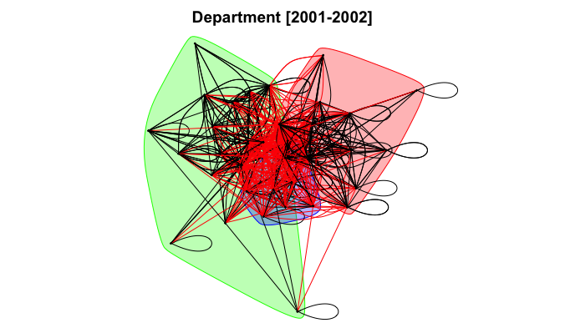
Department Collusion
Lesser number of cluster during these years as information sharing is prevalent now between departments
Colored regions indicate closely interacting departments
Inference 3 :Departments kept information in closed communities earlier with
insider info carriers; more carriers in later time with more collusion.

Slide 18
Conclusion
Not only semantic meanings of the mails [NLP based approach] is important to discover unethical communications, but so is Network Modeling of people.

Slide 19
Unimplemented Ideas
Engineer/transform selected features into new features appropriate for classification modeling( on the basis of some labeled data from Network Analysis).
Test different classifiers using grid search and review performance. Investigate new data sources that may exist to provide better model performance

